Slide 1

UNIVERSITY INSTITUTE OF ENGINEERING
COMPUTER SCIENCE ENGINEERING
Computer Vision (CST-422)
Prepared By : Payal Thakur(E12720)
Topic: Mars Rover: Your Final Project
DISCOVER . LEARN . EMPOWER

Slide 2
Mars Rover: Your Final Project
Stitch Together Images from the Mars Curiosity Rover
The Mars Curiosity rover has several cameras and scientific instruments. The images are available on the web.
Your goal is to create a fuller view of the martian landscape by stitching together two images from the rover's left navigation camera.

Slide 3
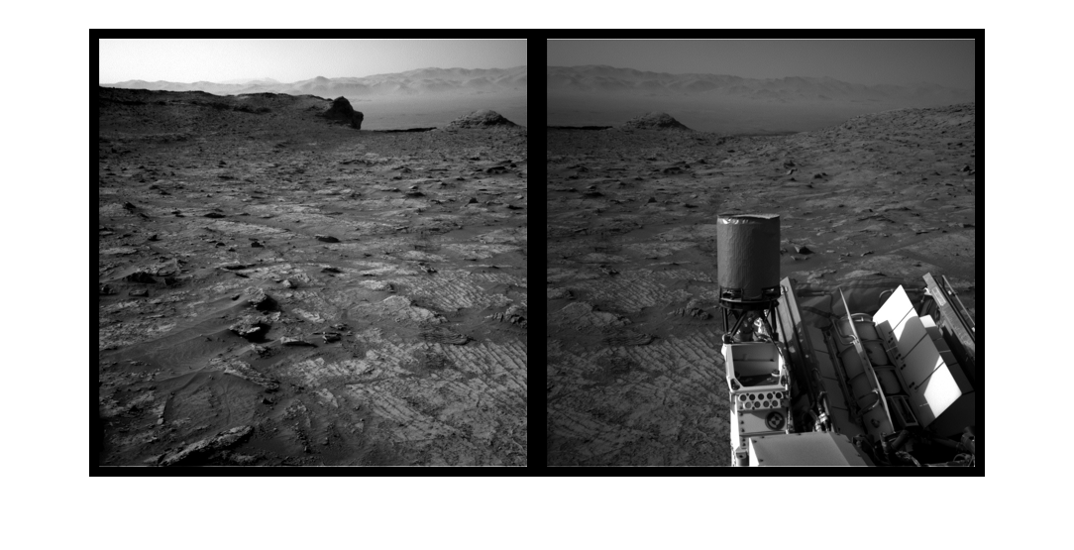
Introduction to Image Stitching

Slide 4
Part 1: Register the Two Images
First, use the Registration Estimator app to create a registration function for the two images. Then, confirm that your function behaves as expected by submitting it for grading using the online MATLAB Grader.

Slide 5
Part 2: Initialize the Panorama
Once your registration function is correct, initialize the panorama image..

Slide 6
Part 3: Create the Panorama
Once you've determined the size correctly, the last step is for you to warp the images and place them in the final panorama.

Slide 7
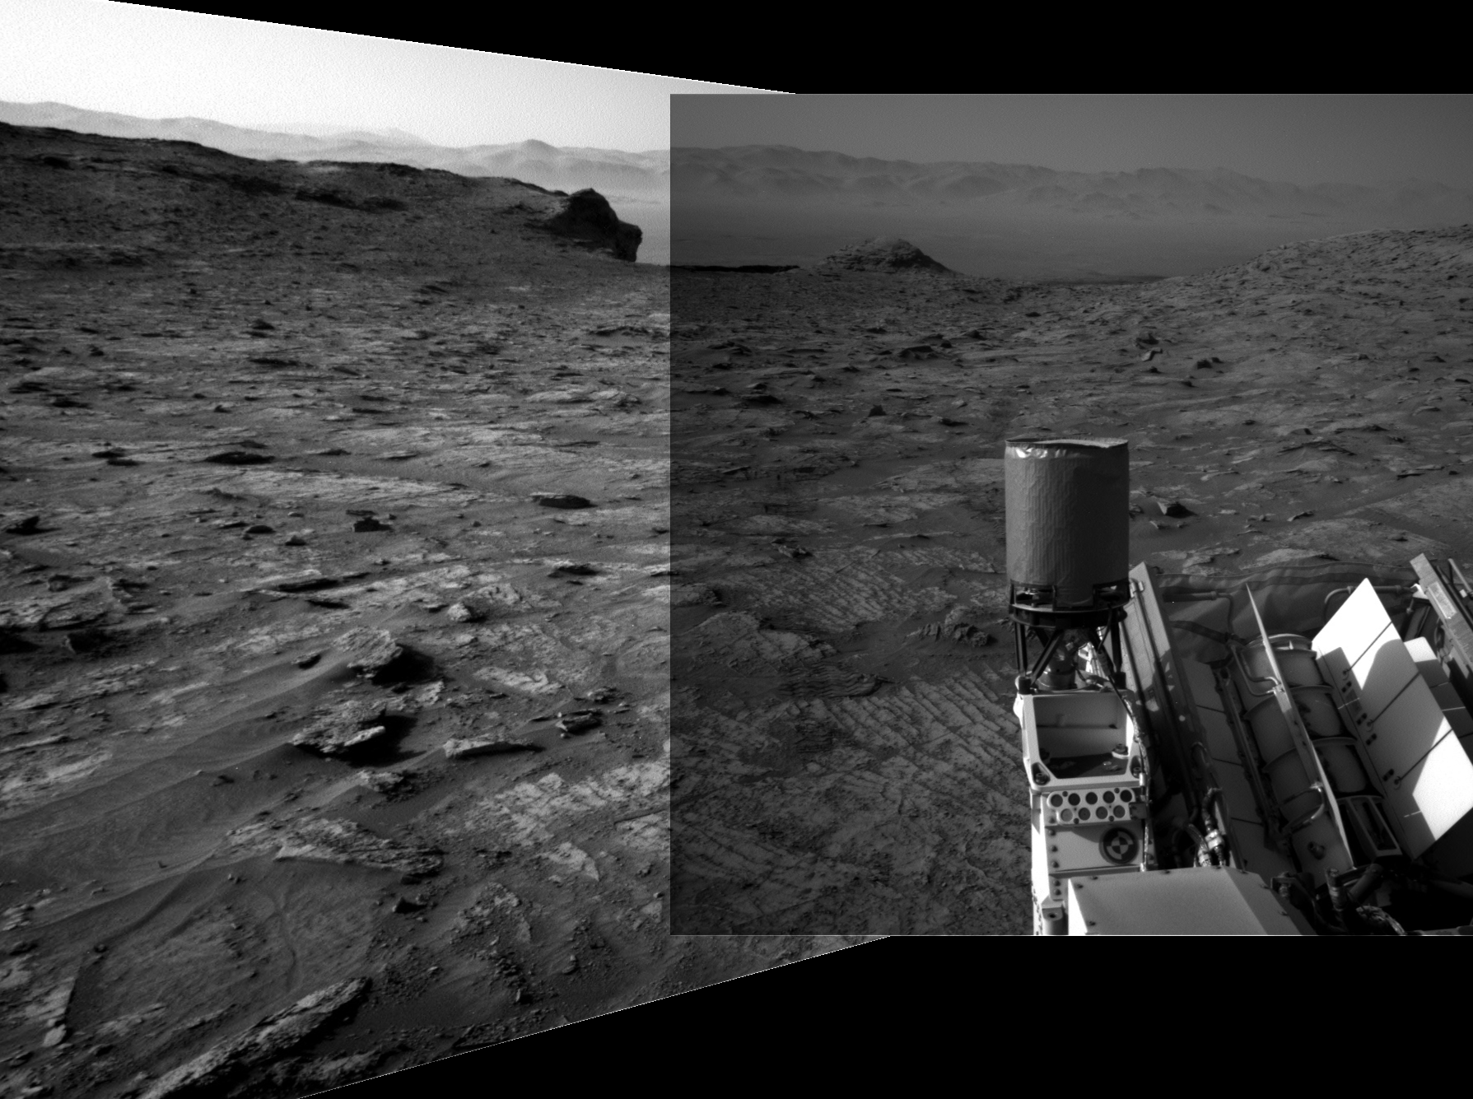
Your final image will look something like this

Slide 8
References:-
Books:-
"Computer Vision: Algorithms and Applications" by Richard Szeliski. Chapter 6: Image Alignment and Stitching covers the topic of image registration and related concepts.
"Digital Image Processing" by Rafael C. Gonzalez and Richard E. Woods. Chapter 4: Image Transforms in Image Processing provides a comprehensive overview of image transformations.
"Computer Vision: A Modern Approach" by David A. Forsyth and Jean Ponce. This textbook provides a comprehensive introduction to computer vision, covering both traditional and modern techniques. It covers topics such as feature extraction, feature matching, motion estimation, and object tracking. The book includes numerous illustrations, exercises, and MATLAB code snippets.
Video Links
"Feature Detection and Description" by Stanford University - Computer Vision (CS231n). Available on YouTube: https://www.youtube.com/watch?v=H-HVZJ7kGI0
"Feature Matching and Homography" by University of Washington - Computer Vision (CSE 576). Available on YouTube: https://www.youtube.com/watch?v=uvSCXyYpG9k
"Introduction to Feature Detection and Matching" by OpenCV. Available on YouTube: https://www.youtube.com/watch?v=AWoG8vdw4pA

Slide 9
THANK YOU
For queries
Email: payal.e12720@cumail.in

